Slide 1

Introduction à
ReactJS
A JavaScript library for building user interfaces

Slide 2

Renaud Dumont
Développeur / MVP Reconnect
Coach et Support technique pendant les stages au MIC

Slide 3

Caractéristiques
Orienté UI : crée des interfaces complexes et réactives
Syntaxe déclarative : simple à comprendre et débuguer
Orienté composants : un composant gère son propre état
Technologie agnostique : peu importe la stack technologique utilisée
Notes:
https://reactjs.org/
Examples : https://reactjs.org/community/examples.html https://react-shopping-cart-67954.firebaseapp.com/
https://flatris.space/
http://clocks.80limit.com/

Slide 4
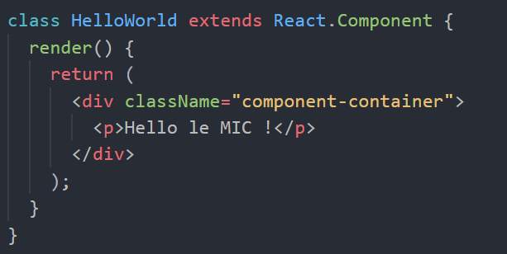
Un simple composant
Notes:
Pourquoi le navigateur ne comprend pas la partie dans le return ?
Parce que ce n’est ni du javascript, ni de l’html. C’est un langage appelé JSX, qui sert à écrire du code pour créer des interfaces de manière déclarative.
En vérité, ce code doit être transformé dans un langage que le navigateur peut comprendre (du javascript).
return e("div", { className: "component-container" }, [
e("p", { key: 1 }, "Hello le MIC"),
e("p", { key: 2 }, Math.random() * 1000)
]);

Slide 5
DATA
Les données qui doivent être présentées par ce composant
ETAT D’UN COMPOSANT
UI-STATE
L’état visual du composant

Slide 6
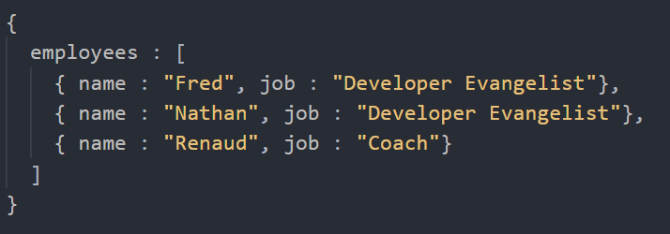
État d’un composant : Données

Slide 7
État d’un composant : Données

Slide 8
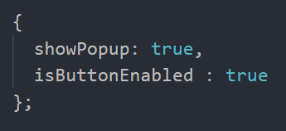
État d’un composant : État visuel

Slide 9
React Developer Tools
Notes:
https://chrome.google.com/webstore/detail/react-developer-tools/fmkadmapgofadopljbjfkapdkoienihi
Démo de la todo list sur https://reactjs.org/

Slide 10
User Interface events Mouse events Focus & Blur events Form events
Keyboard events HTML5 events CSS events
GESTION DES
EVENEMENTS

Slide 11
Function Scope
Bien gérer le mot-clé « this »
Notes:
https://chrome.google.com/webstore/detail/react-developer-tools/fmkadmapgofadopljbjfkapdkoienihi
Démo de la todo list sur https://reactjs.org/

Slide 12
WHAT INSPIRES US
It is better to fail in originality than to succeed in imitation.
HERMAN MELVILLE

Slide 13
MISSION AND VISION
THE KYOBI GOALS
Presentations are communication tools used for reports, speeches and more.

Slide 14

GAMING WITH KYOBI
Presentations are communication tools used for demonstrations, reports, speeches and more.

Slide 15
Gaming Consoles
THE KYOBI 1
KYOBI REMASTERED
Presentations are communication tools used for reports and more.
Presentations are communication tools used for reports and more.
POCKET KYOBI
THE KYOBI MAX
Presentations are communication tools used for reports and more.
Presentations are communication tools used for reports and more.

Slide 16
OTHER CONSOLES
Presentations are communication tools used for reports and more.
KYOBI CONSOLES
Presentations are communication tools used for reports and more.

Slide 17
INDUSTRY FACTS
8 OUT OF 10
HOUSEHOLDS OWN A KYOBI
Presentations are communication tools.

Slide 18
Presentations are communication tools that can be demonstrations, reports, and more.

Slide 19
CUTTING-EDGE PERFORMANCE
INTRODUCING KYOBI X
GAMING REDEFINED

Slide 20
WHAT SETS
OURS APART?
OUR STRIVE FOR CONSTANT INNOVATION AND CHANGE.

Slide 21
THE KYOBI X
SLEEK AND MINIMAL
Presentations are communication tools.
FASTEST TECHNOLOGY
Presentations are communication tools.
UPDATED GRAPHICS
Presentations are communication tools.

Slide 22
THE KYOBI AESTHETICS
ORIGINAL COLORWAYS
ORIGINAL COLORWAYS
IN-DEPTH LOOK
Presentations are tools used for reports, speeches and more.
Presentations are tools used for reports, speeches and more.

Slide 23
Dimensions and Characteristics
LIGHTWEIGHT
PORTABLE
SHATTER
PROOF
TEMPERATURE RESISTANT
Presentations are tools used for reports, speeches and more.
Presentations are tools used for reports, speeches and more.
Presentations are tools used for reports, speeches and more.
Presentations are tools used for reports, speeches and more.

Slide 24
Building the X
INSPIRATION
Presentations are tools for demonstrations
used for reports, speeches and more.
PLANNING
Presentations are tools for demonstrations
used for reports, speeches and more.
CONSTRUCTION
Presentations are tools for demonstrations
used for reports, speeches and more.

Slide 25
CONSOLE FEATURES
A LOOK INTO THE X
Seamless Integration
New Controllers
Surround Sound

Slide 26
FEEDBACK
Presentations are tools for reports, speeches and more.
IMPROVING EVERY RELEASE
INNOVATION
Presentations are tools for reports, speeches and more.
BETA TESTING
Presentations are tools for reports, speeches and more.

Slide 27
87%
99%
WANT AN UPDATED CONSOLE
ARE HAPPY WITH KYOBI

Slide 28
JANUARY
Presentations are communication tools for reports, speeches and more.
FEBRUARY
Presentations are communication tools for reports, speeches and more.
CONSOLE RELEASE DATES
MARCH
Presentations are communication tools for reports, speeches and more.
AROUND THE WORLD
APRIL
Presentations are communication tools for reports, speeches and more.

Slide 29
Introducing the X
Presentations are communication tools for reports, and more.

Slide 30
60
THE FUTURE OF GAMING
40
GROWING POPULARITY
20
Presentations are communication tools that can be demonstrations, reports, and more.
0
Item 1
Item 2
Item 3
Item 4
Item 5

Slide 31
MEET THE TEAM
BEHIND KYOBI X
BRAEDEN JEFFRIES
President and CEO
BELINDA CARLISLE
Lead Designer
LEENA MARICK
Senior Programmer

Slide 32



Reach Us Here
FACEBOOK
TWITTER
INSTAGRAM
Presentations are communication tools.
Presentations are communication tools.
Presentations are communication tools.

Slide 33
MAILING ADDRESS
123 Anywhere St., Any City, State, Country 12345
GET IN TOUCH
EMAIL ADDRESS
hello@reallygreatsite.com
FOR CONCERNS
PHONE NUMBER
(123) 456 7890

